Slide 1
Applications of kmer analysis in quantitative biology
Reviews in Quantitative Biology
Sina Majidian
November 18th, 2022

Slide 2
Outline
Introduction
DNA sequencing
Kmer definition
Minimizer definition
Applications
Metagenomics
Genome assembly
Kmer counting
Discussion

Slide 3
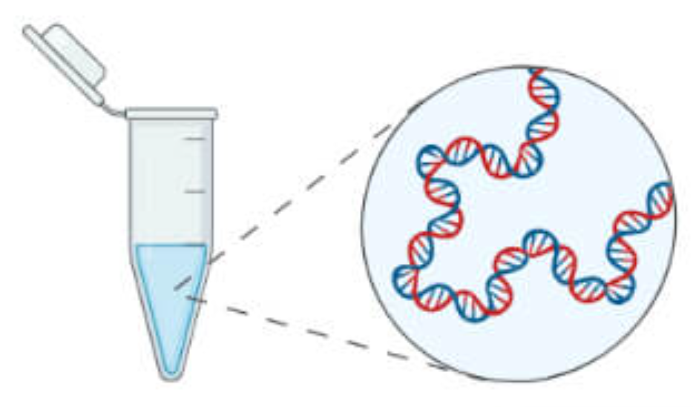
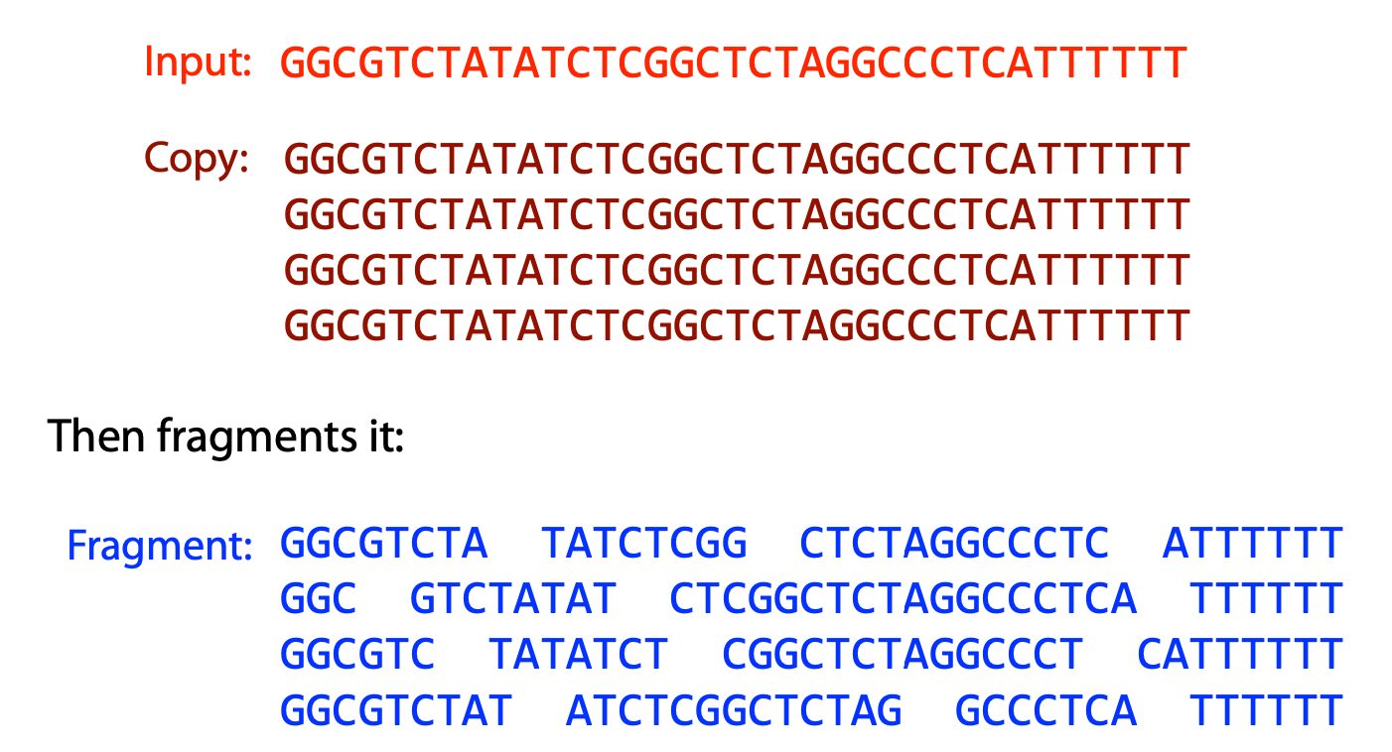
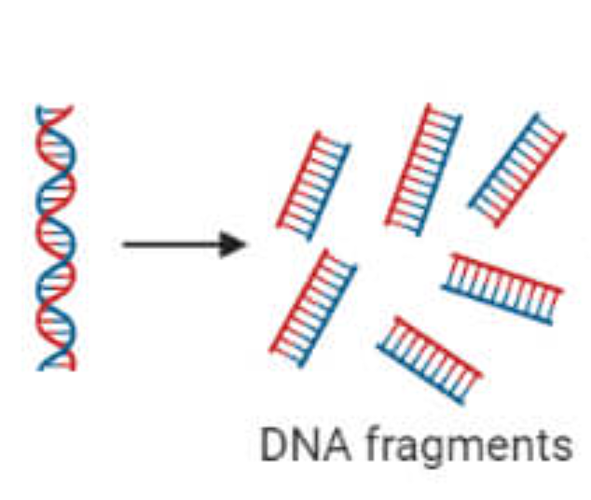
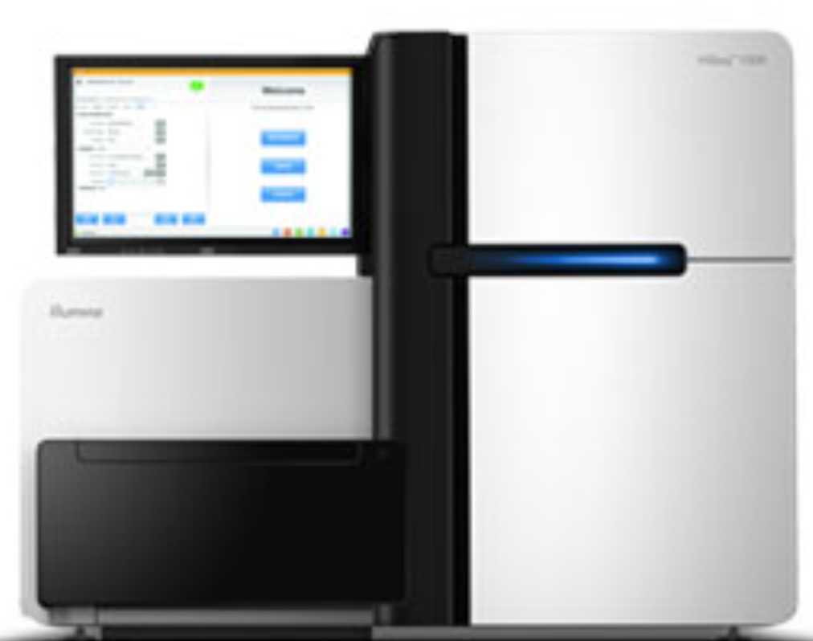
DNA Sequencing
DNA extraction
Amplification
Sequencing
Notes:
Sanger, short read (illumina), Long read(ONT, PacBio)

Slide 4
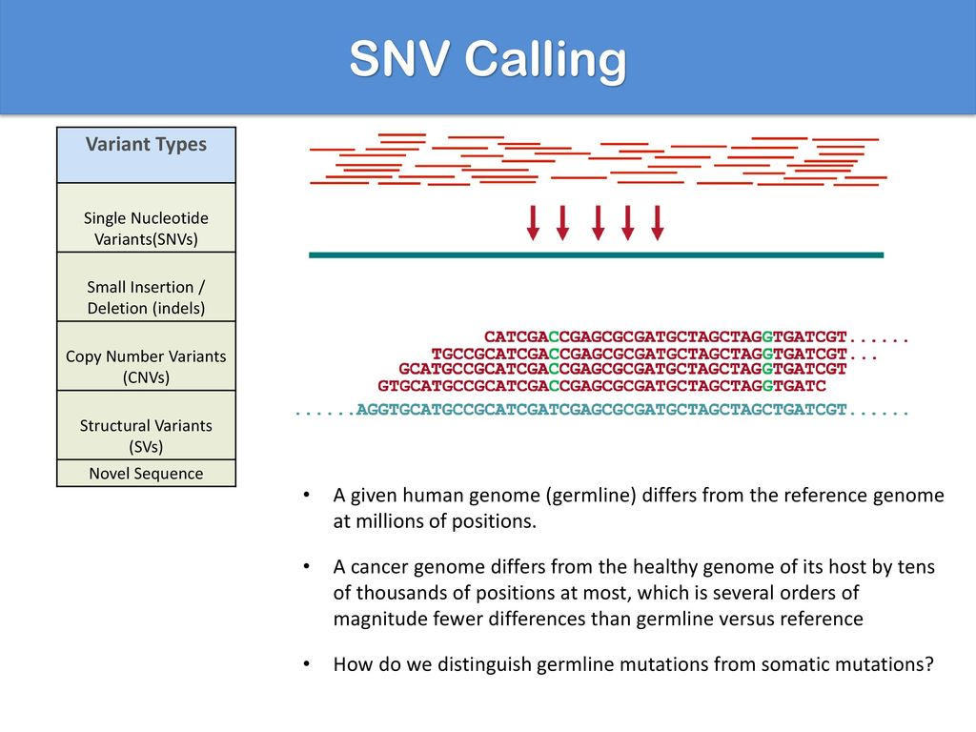

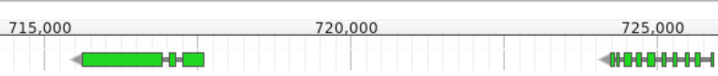
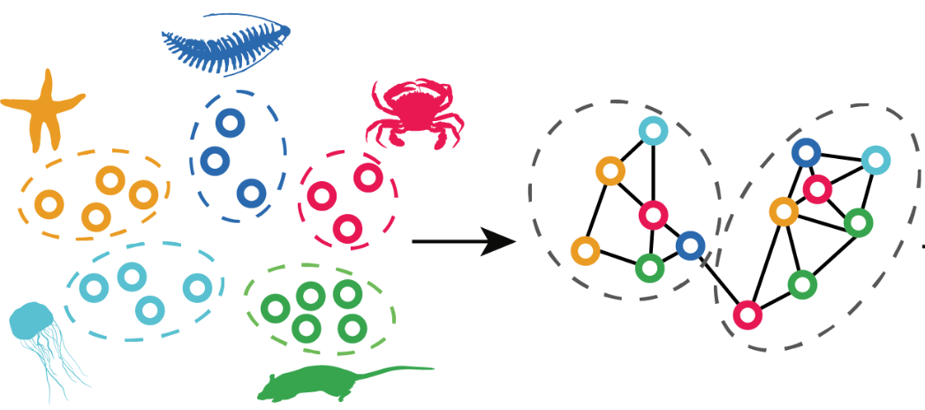
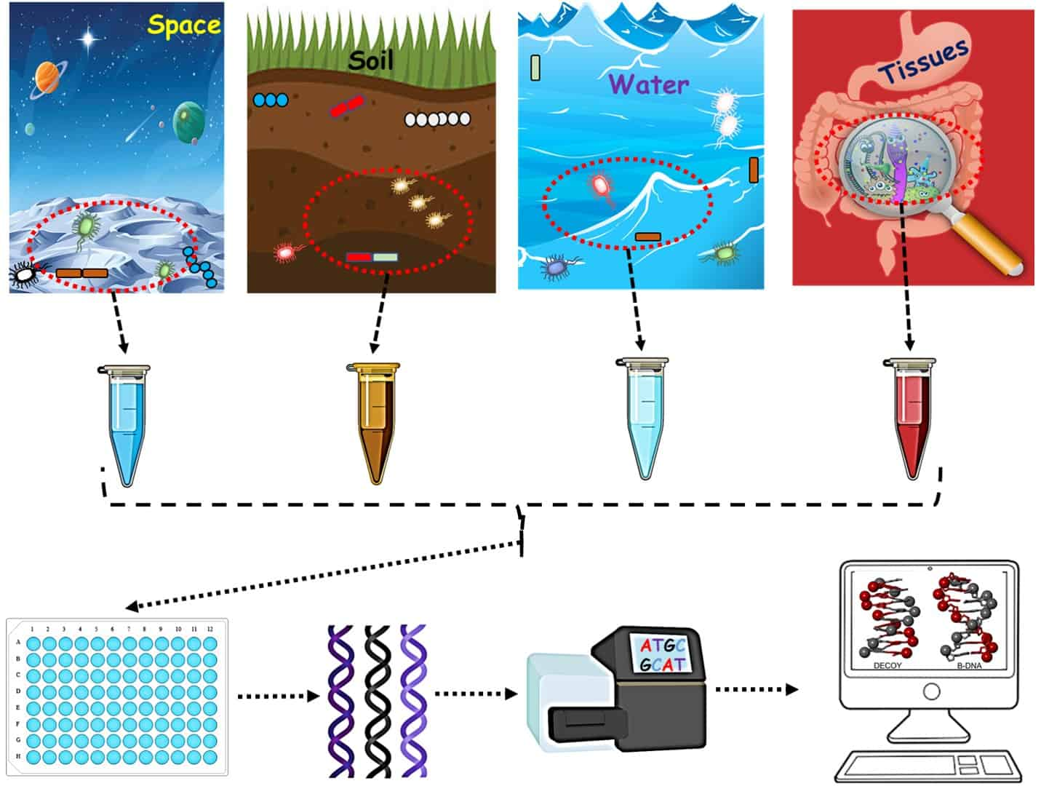
Genomics pipelines
4) Read alignment
5) Variant calling & genotyping
1) De novo genome assembly
2) Gene annotation
6) Metagenomics
3) Orthology inference
Notes:
1) sequence new species, no reference genome
3) pattern of evolution
4) having reference genome

Slide 5
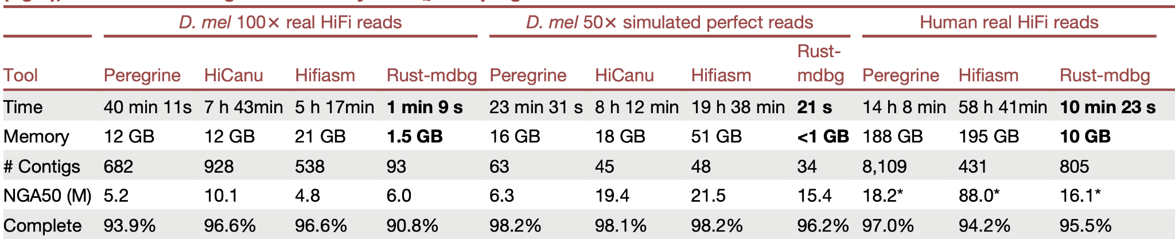
Genome assembly: importance of scalable methods
We need efficient methods in terms of memory, speed and storage.
Minimizer-space de Bruijn graphs: Whole-genome assembly of long reads in minutes on a personal computer, Cell Systems, 2021.

Slide 6
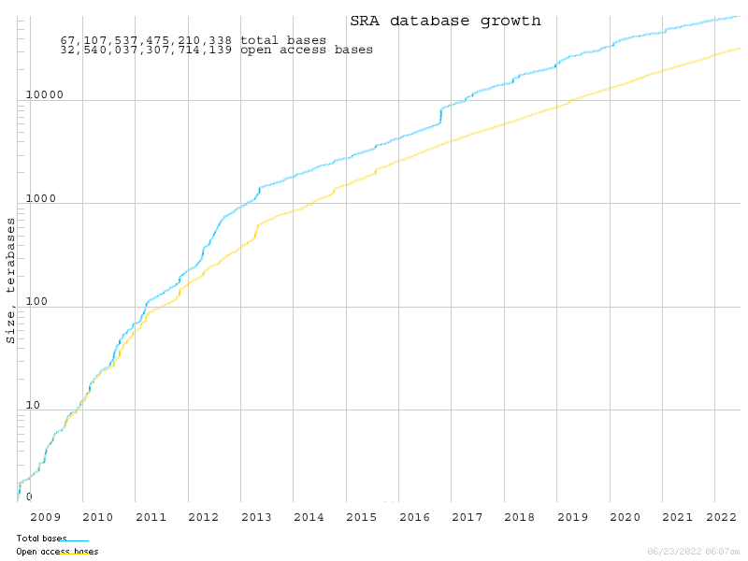
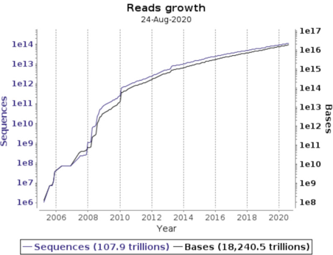
Fast growing genomics data
The European Nucleotide Archive in 2020, Nucleic Acids Research
ncbi.nlm.nih.gov/sra/docs/sragrowth/
Notes:
I don’t need to convince you
Cannot download them all, nor perform sequence search
trillion = a million million = 10^12

Slide 7

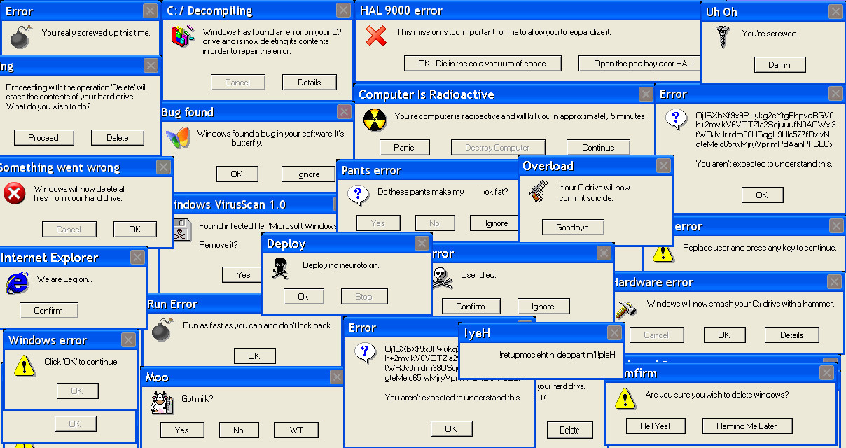
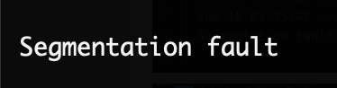




Notes:
Core dumped No Space Left on Device Segmentation fault No one else cannot login
store, compress collections of high-throughput sequencing data sets in a manner that supports various queries.

Slide 8
Basics on K-mer & Minimizers
Notes:
Let’s start with the basics, then we see the applications

Slide 9
K-mer definition
a contiguous substring of length k.
alphabet= {A,C,G,T}
string (sequence)= GATTACA
Example: k=2, 2mers
GATTACA
GATTACA
GATTACA
GATTACA
GATTACA
GATTACA
GA, AT, TT, TA, AC, CA
Number of 2-mers = 6
https://www.youtube.com/c/RobEdwardsVideos/videos
http://www.langmead-lab.org/teaching-materials/
Notes:
let

Slide 10
K-mer stats
GATTACA
GATTACA
GATTACA
GATTACA
GATTACA
For the same sequence GATTACA
k=3: GAT, ATT, TTA, TAC, ACA
k=4: GATT, ATTA, TTAC, TACA
How many 3-mers do exist for a sequence of length L=100?
Number of 3-mers = 100-3+1 = 98 (L-k+1)
How many different 3-mers do exist?
4^3=64 (4^k)
Notes:
https://www.youtube.com/c/RobEdwardsVideos/videos
http://www.langmead-lab.org/teaching-materials/

Slide 11
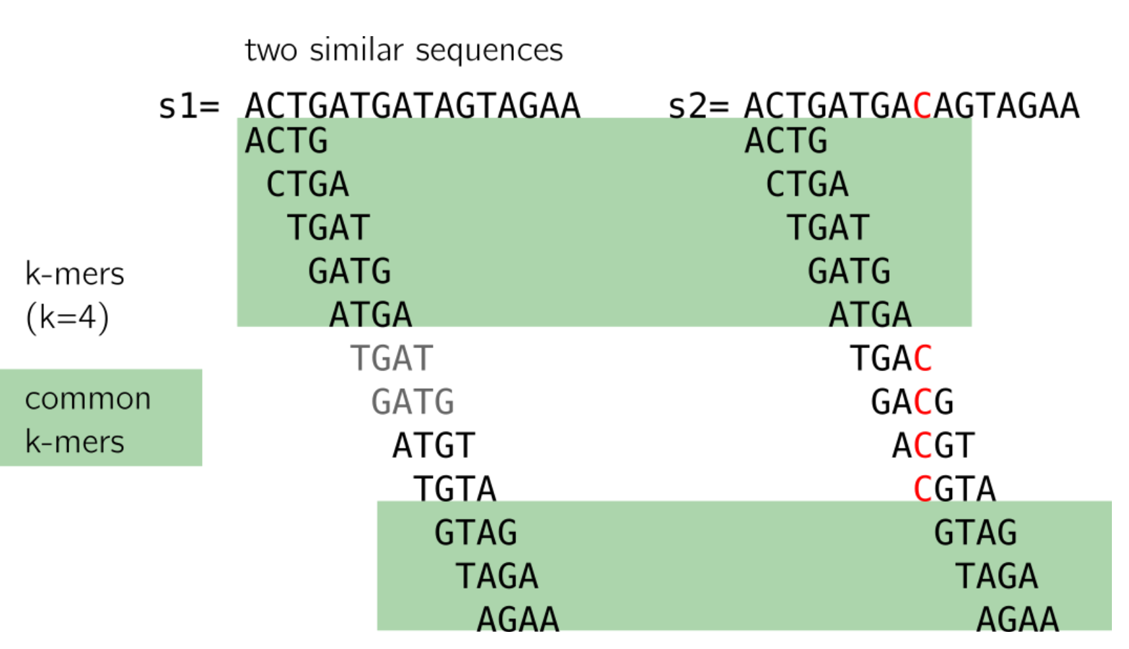
Sequence comparison
Two similar sequences with one base error:
Many shared 4-mers (green)
Neighbors of C/T are not shared.
Repeated kmers
kamimrcht.github.io/webpage/strobemers.html

Slide 12
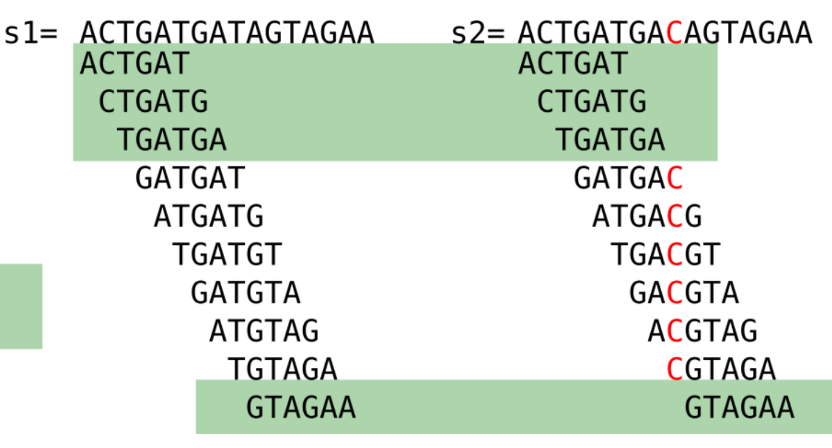
Impact of k on specificity
By increasing k, we can keep the differences.
Notes:
Depending on the applications and error profile.

Slide 13
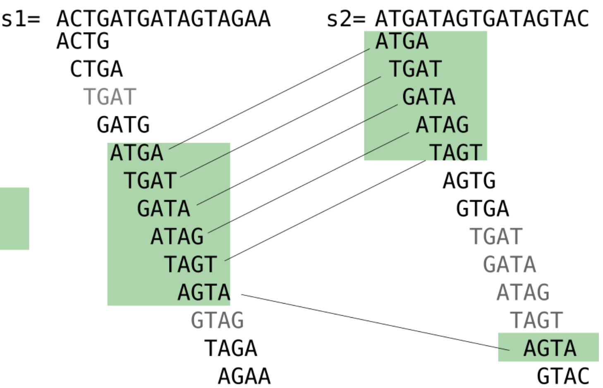
Impact of k on specificity
Two not so similar sequences:
Still a lot of shared 4-mers
Number 5-mers= 4^5=1024
Every 1k, one shared kmer by chance. (if distributed uniformly)

Slide 14
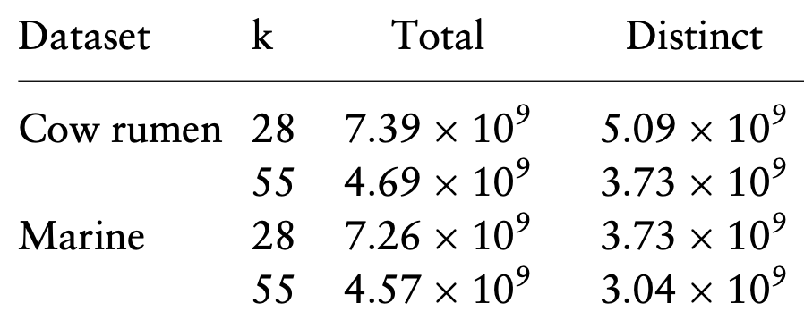
K-mer stats
Billions (10^9) of k-mers exist in a metagenomic datasets,
resulting in computational challenges
GATTACA
GATTACA
GATTACA
GATTACA
GATTACA
Each k-mer contains little information compared to the nearest one.
Idea: sampling (also referred to as “sketching”)
Table from “Compact and evenly distributed k-mer binning for genomic sequences.” Bioinformatics, 2021
Notes:
(SRR094926, ERR599052)

Slide 15
Minimizer
GATTACA
GATTA
GATTA
GATTA
The smallest kmer in a window.
alphabetical order: AA <AT
Window of size 5, 3-mers.
GATTACA
1st window
1st window GATTA : ATT
ATTAC
ATTAC
ATTAC
GATTACA
2nd window ATTAC : ATT
2nd window
3rd window TTACA : ACA
Minimizers for GATTACA are ATT, ACA.
(2 fingerprints instead of 5 kmers)
Similar sequences ~ shared minimizers.
TTACA
TTACA
TTACA
GATTACA
3rd window
Reducing storage requirements for biological sequence comparison. Bioinformatics, 2004.
Notes:
lexical order, usually neighbouring windows have similar minimizer
Minimizers tend to stay (locally) constant for overlapping windows
There are fewer different minimizers than windows
a new minimizer occurs about once every half-window width.
2/(w + 1) of all k-mers are (w, k)-minimizers,

Slide 16
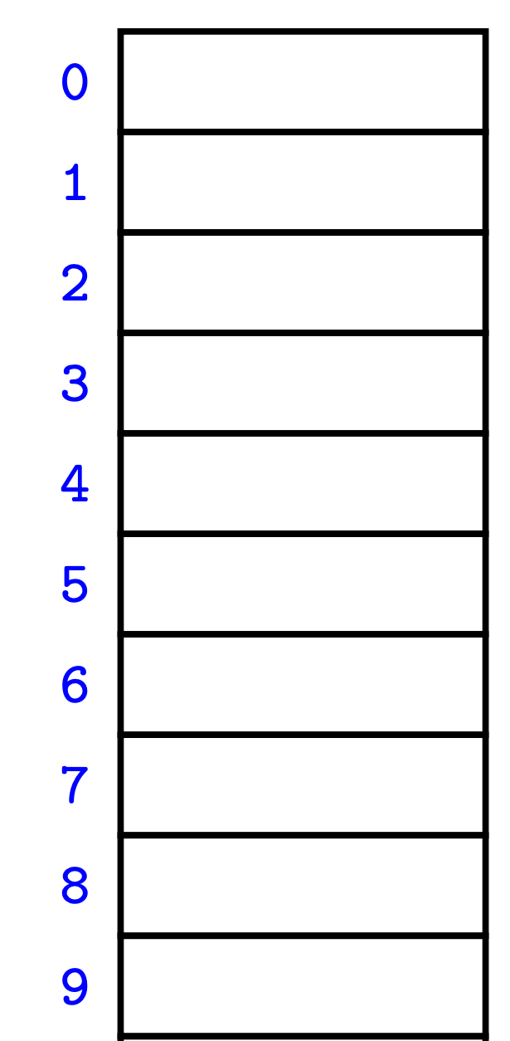
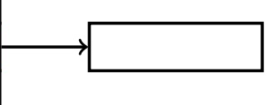
Different ordering
3. Hash function
h(x) = x mod 11
“remainder of a division by 10”
AA=11 -> {AA:1}
1. Alphabetical order: AA <TT
2. Defining a function on a string
A=1, C=2, G=3, T=4
TAAT = 4114
CTTT = 2444
TAAT > CTTT
AA
TA
CT:
24 =2*10+ 4
CT
TA:‌
41 =4*10+ 1
Notes:
reverse complement TATCG = CGATA select the smallest called canonical.
Hash: AC 12, GC 32,
MurmurHash3 2^128
Chaining is a technique used for avoiding collisions in hash tables.
In hash literature, people tend to use Hexadecimal. Hexadecimal is a numeral system in base 16 (0,1,2,3,4,5,6,7,8,9,A,B,C,D,E,F). 27 = 0x1B B x 1 = 11, 1 x 16 = 16, 11 + 16 = 27

Slide 17
Applications
1- Metagenomics

Slide 18
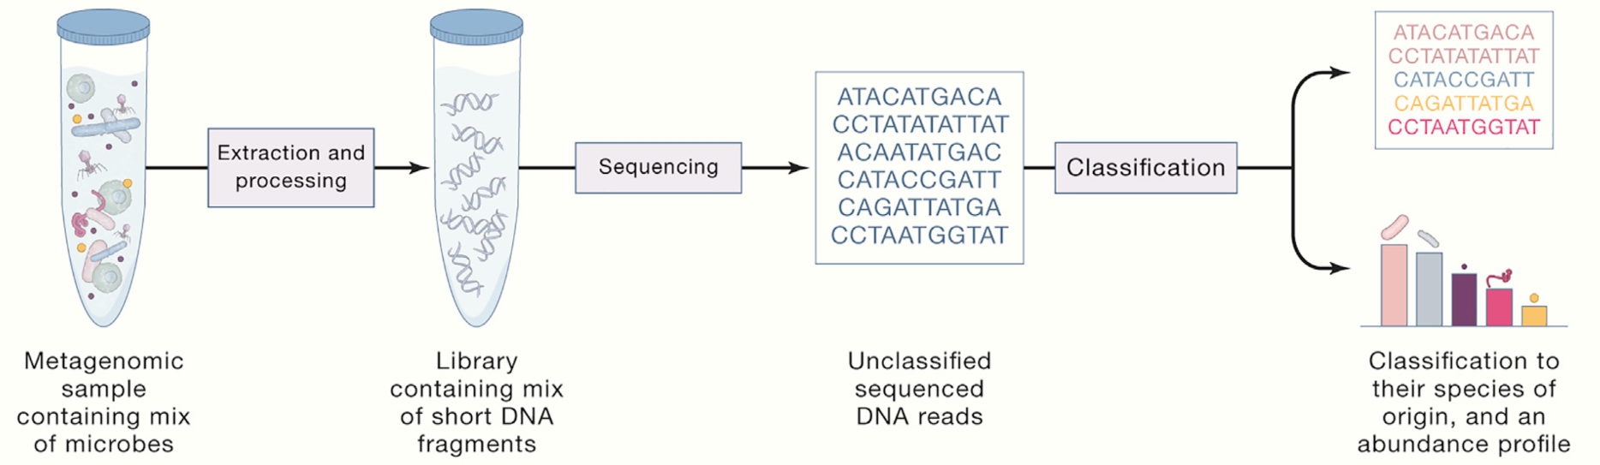
Metagenomics
Metagenomics: the study of genomic sequences obtained directly from an environment (gut microbiome, wastewater surveillance, ..)
Benchmarking Metagenomics Tools for Taxonomic Classification, Cell 2019

Slide 19
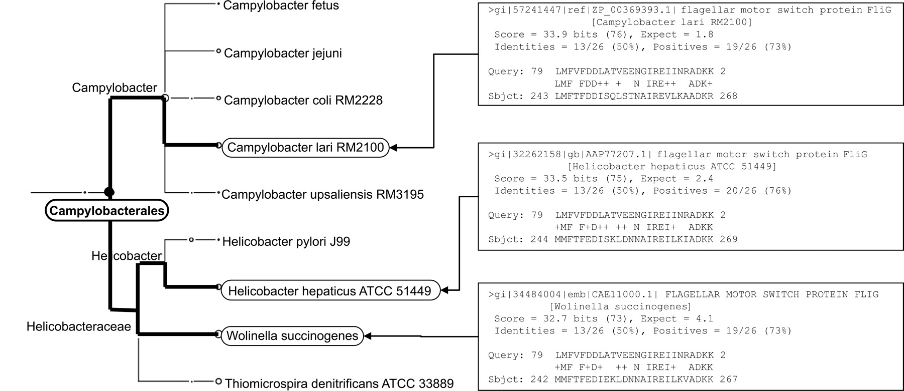
MEGAN: exploring taxonomical content
BLASTX read1 against NCBI-NR
Lowest common ancestor
1st match for read1
2nd match for read1
3rd match for read1
MEGAN analysis of metagenomic data, Genome research, 2007 (3k citations)
Notes:
Goal is to estimate the taxonomic level for each sequencing reads.
Each read may have hit on proteins from different species.
significant blast alignments: > 0.9 best score

Slide 20
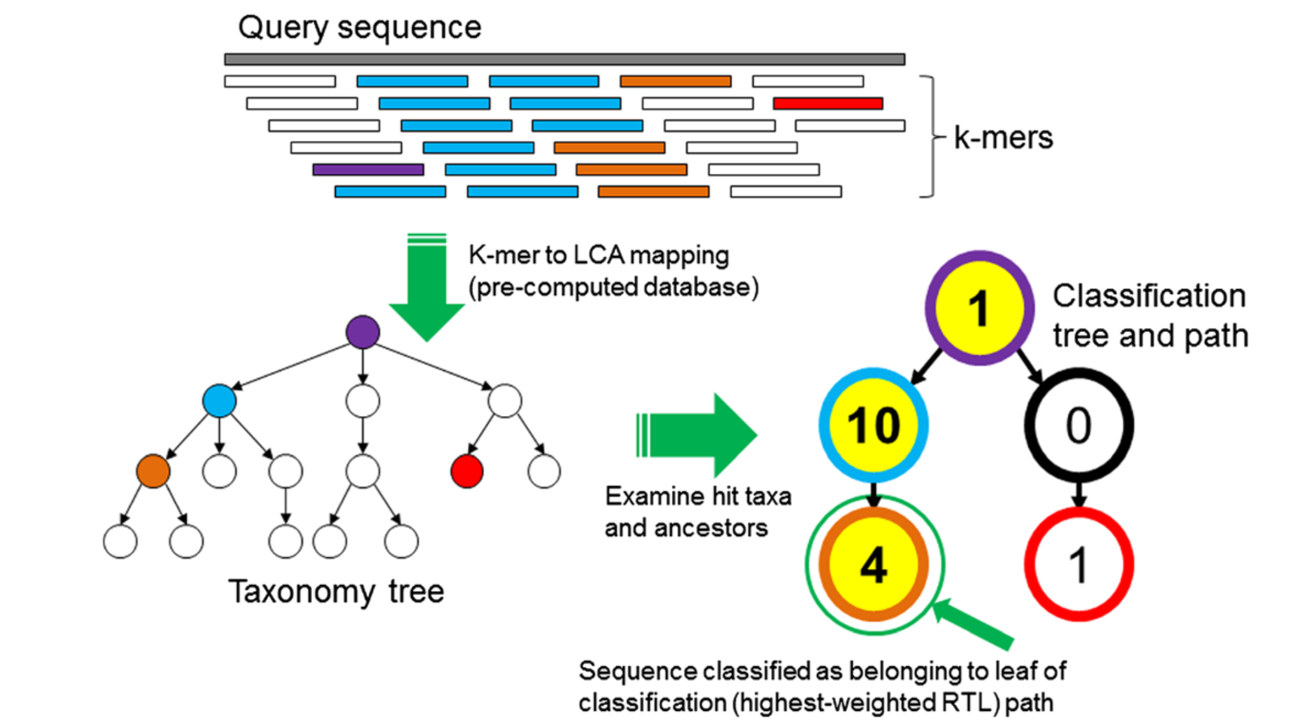
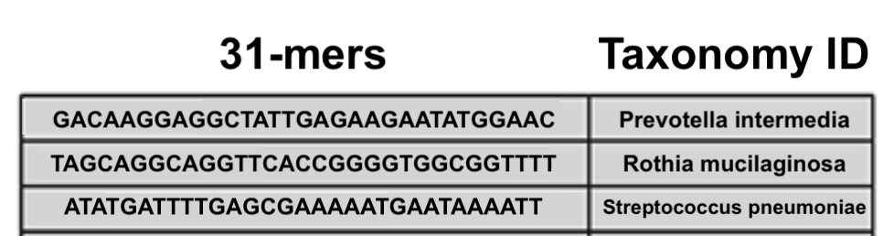
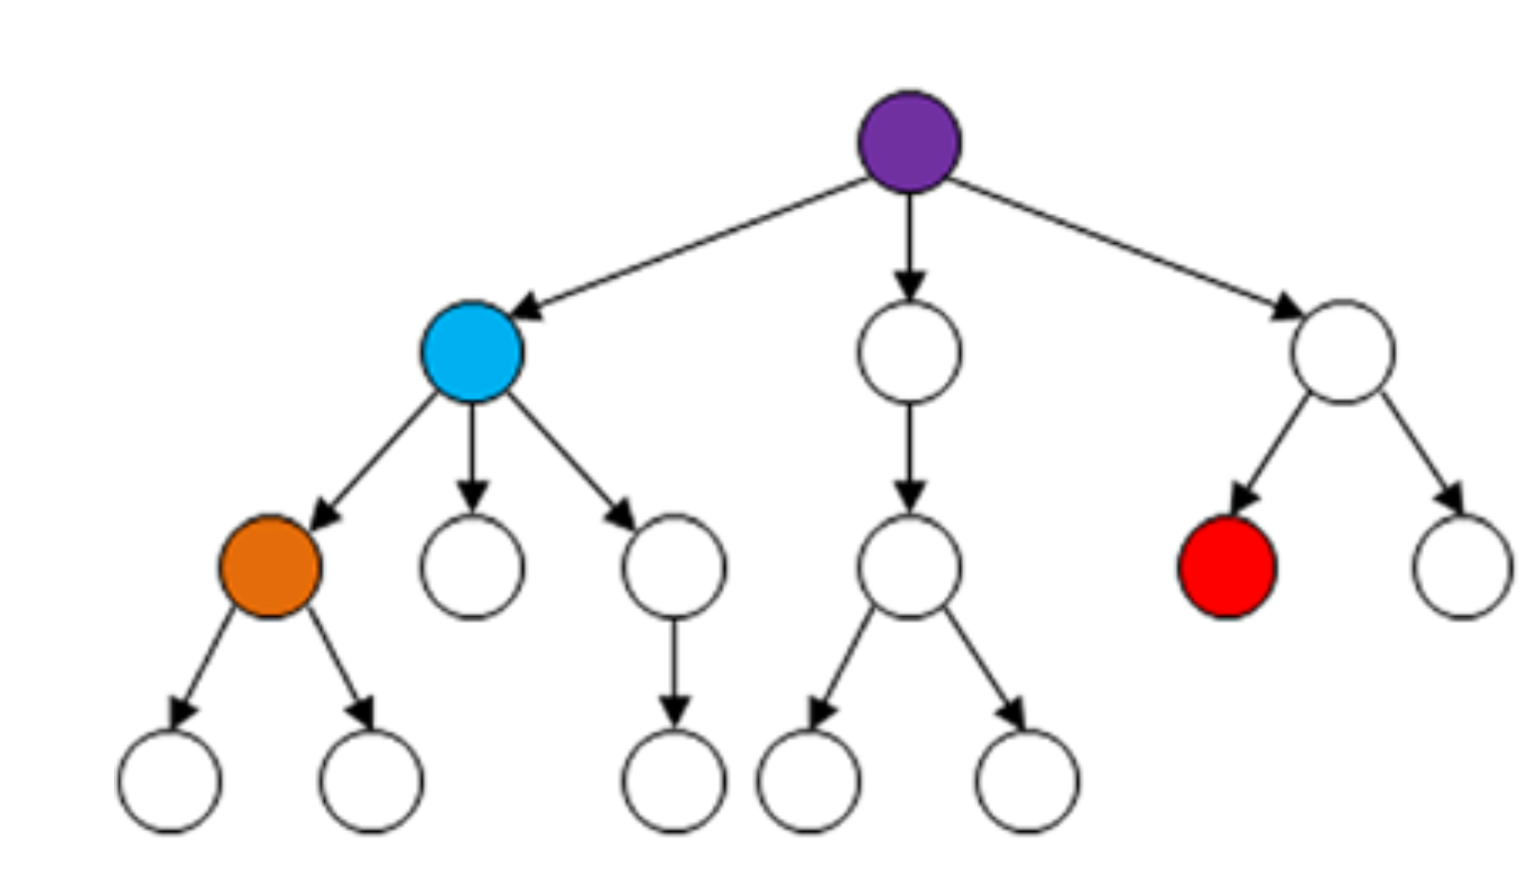
Kraken: assigning taxonomic labels
query metagenomics sequencing read
1. Extract k-mers from the input sequencing read (query)
2. Use precomputed database, extract the taxonomic ID of 31-mers
3. Count # kmers assigned to each taxonomic level
4. Find the path with maximum sum
5. Report the leaf as the taxonomic label
Kraken: ultrafast metagenomic sequence classification using exact alignments, Genome biology, 2014 (3k citations)
Notes:
Lowest common ancestor
Kraken is another tool for assigning taxonomic labels to metagenomic DNA sequences.

Slide 21
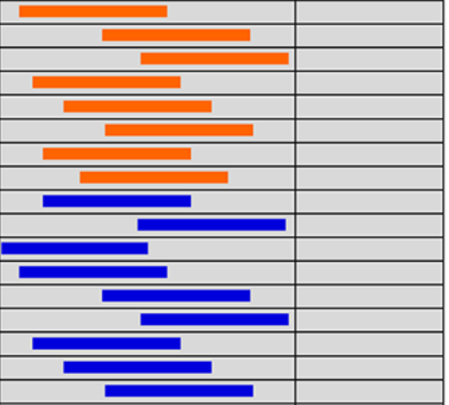
Kraken: kmer-LCA table
To speed up kmer search in the table
Use 15mer minimizer for grouping similar 31mer
Pre-computing the kmer-LCA database
Extract all 31-mers from microbial genome in NCBI RefSeq
15mer
15mer
31-mers
Fill the table with 31-mers of shared minimizer near each other
For a 31-mer query, start searching within its minimizer
Kraken: ultrafast metagenomic sequence classification using exact alignments, Genome biology, 2014 (3k citations)
Notes:
Assign a taxon for each kmer,
Lowest common ancestor

Slide 22
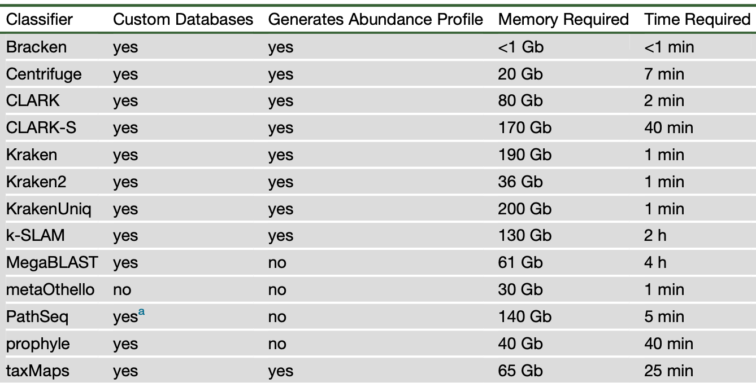
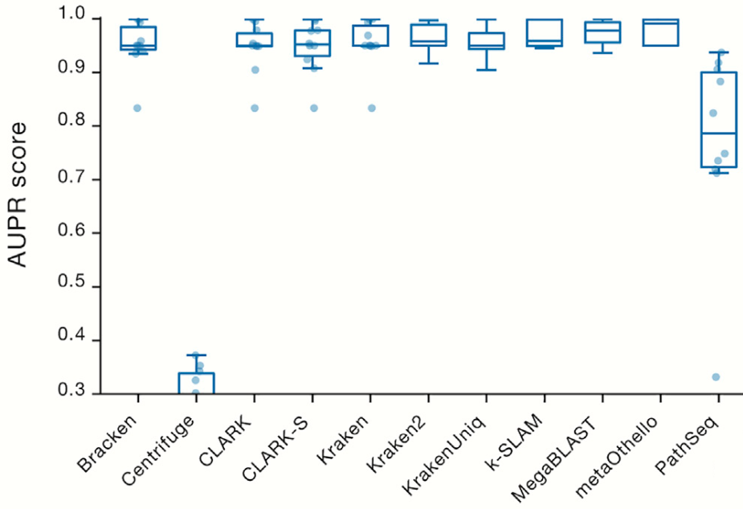
Kraken2 results
Classification accuracy and speed comparison on a simulated dataset
Improved metagenomic analysis with Kraken 2, 2019.
Notes:
Using hashing function
area under the precision-recall curve (AUPR)

Slide 23
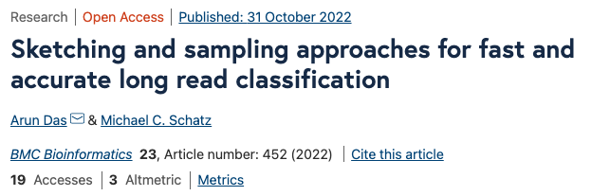
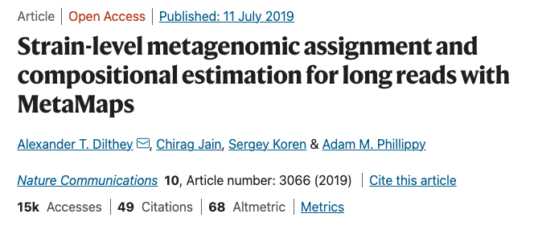
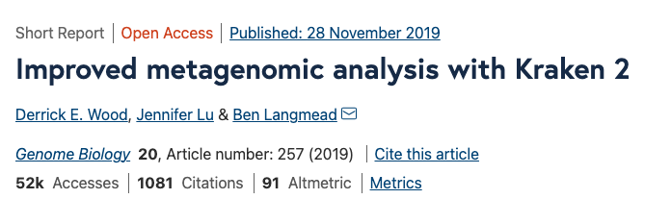
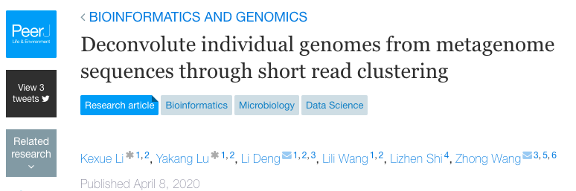
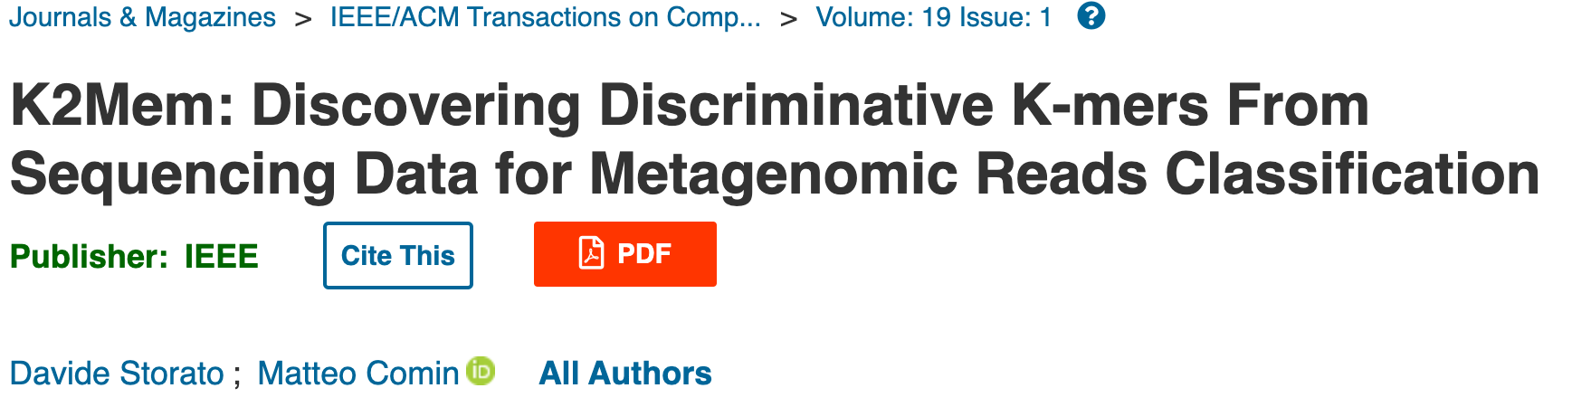
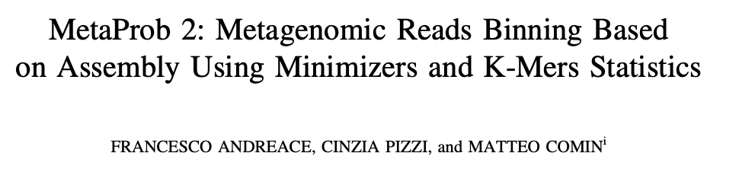
Comparing minimizer with MinHash & ..
Metagenome assembly
Improved kraken2
Metagenome assembly

Slide 24
Applications
2- Genome assembly

Slide 25
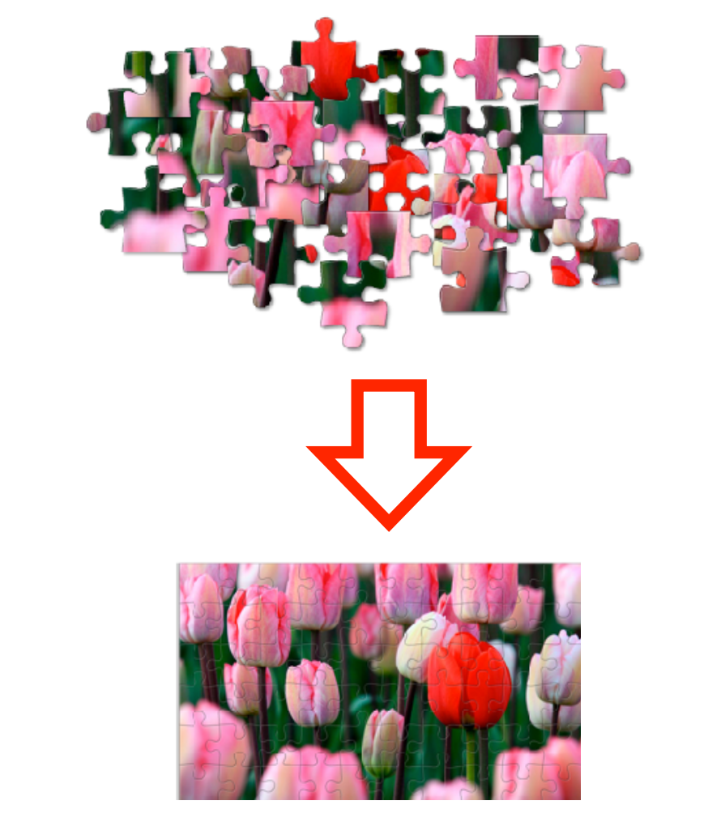
De novo genome assembly
https://langmead-lab.org/teaching-materials/
Notes:
De novo is a Latin term that means "from the beginning”

Slide 26
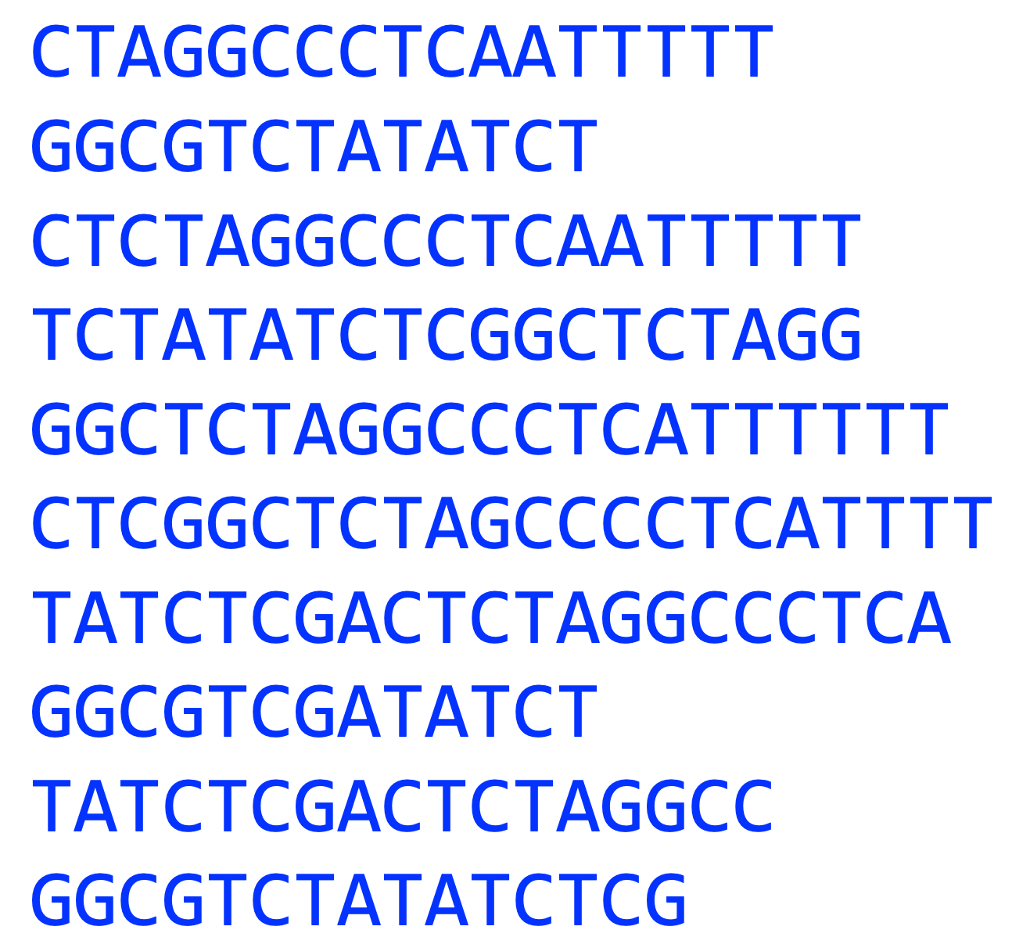
Sequencing reads

Slide 27
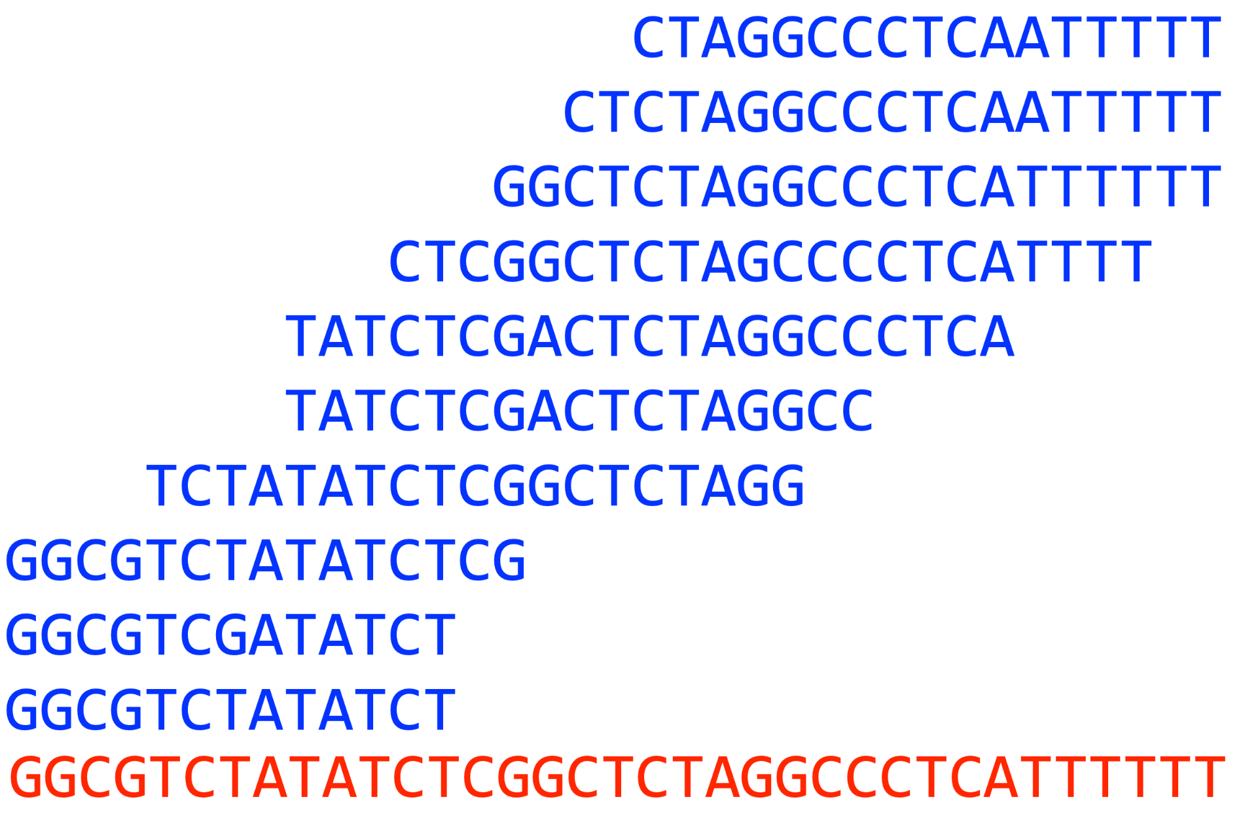
de Bruijn graphs
assemble the genome.
finding overlaps between kmers of reads
Notes:
There are two main approaches for genome assembly : 1) Overlap-Layout-Consensus method
And 2) de Bruijn graphs

Slide 28
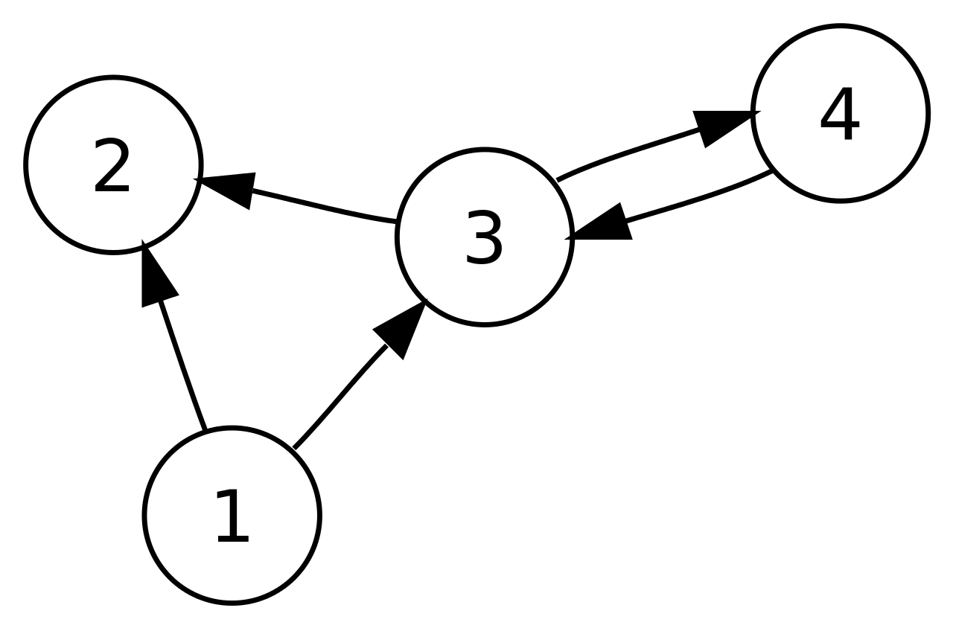
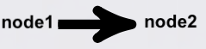
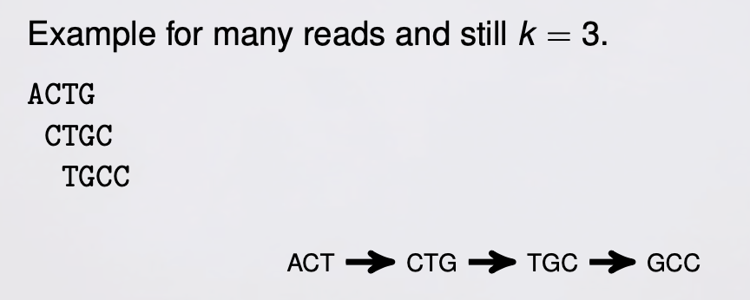
de Bruijn graphs
Graph: nodes, edges
Nodes: kmers
Edge: link between k-mers that overlap by k-1 bases.
Example:
3mers for the sequence ACTG
3mers: ACT, CTG
Merging two nodes result in a K+1 mer (=a part of the sequence).
Compacting de Bruijn graphs from sequencing data quickly and in low memory. Rayan Chikhi, ISMB 201
Notes:
There is also another way of defining de Bruijn graph.

Slide 29
dBG for few reads
ACTG
ACTG
CTGC
CTGC
CTGC
TGCC
TGCC
ACTG
CTGC
TGCC
Short-read metagenomics assembly methods, Rayan Chikhi, EBAME6, 2021.
Notes:
What happens if we add some redundancy?

Slide 30
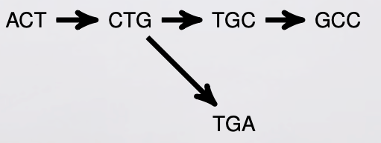
A sequencing error on de Bruijn graph
ACTG
CTGC
CTGA
TGCC

Slide 31
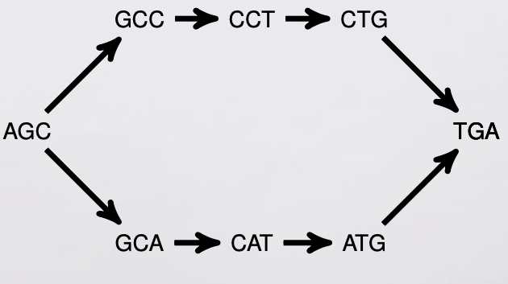
SNPs in the graph
AGCCTGA
AGCATGA

Slide 32
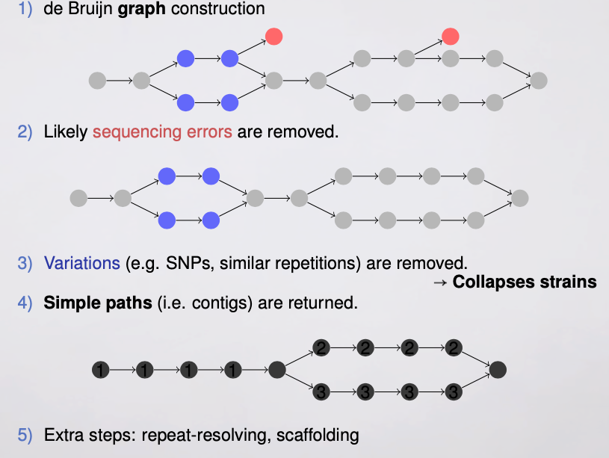
Short read assemblers
Construct de Bruijn graph
Remove likely sequencing errors
Remove variations
Return simple paths (contigs)
Combining all kmers in the path
Extra steps: repeat-resolving, scaffolding
How to apply de Bruijn graphs to genome assembly, Nature biotechnology 2011.

Slide 33
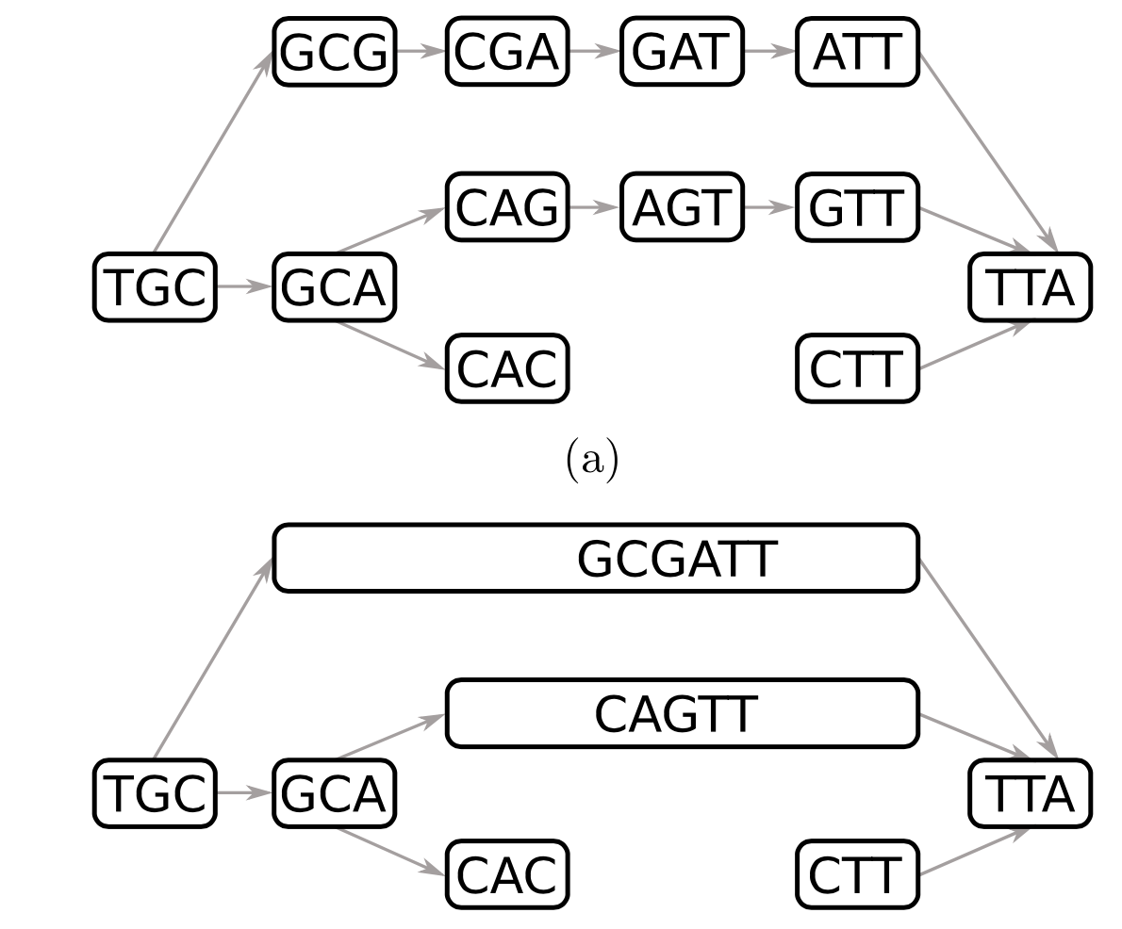
Compacting the de Bruijn graph
1 TB seq data
700 GB kmers
Bifrost: highly parallel construction and indexing of colored and compacted de Bruijn graphs, 2020.
Notes:
The goal is find the path and then combine them. Right?
hundreds of giga-bytes (GB) of memory for human genome assembly
30 GB unitigs

Slide 34
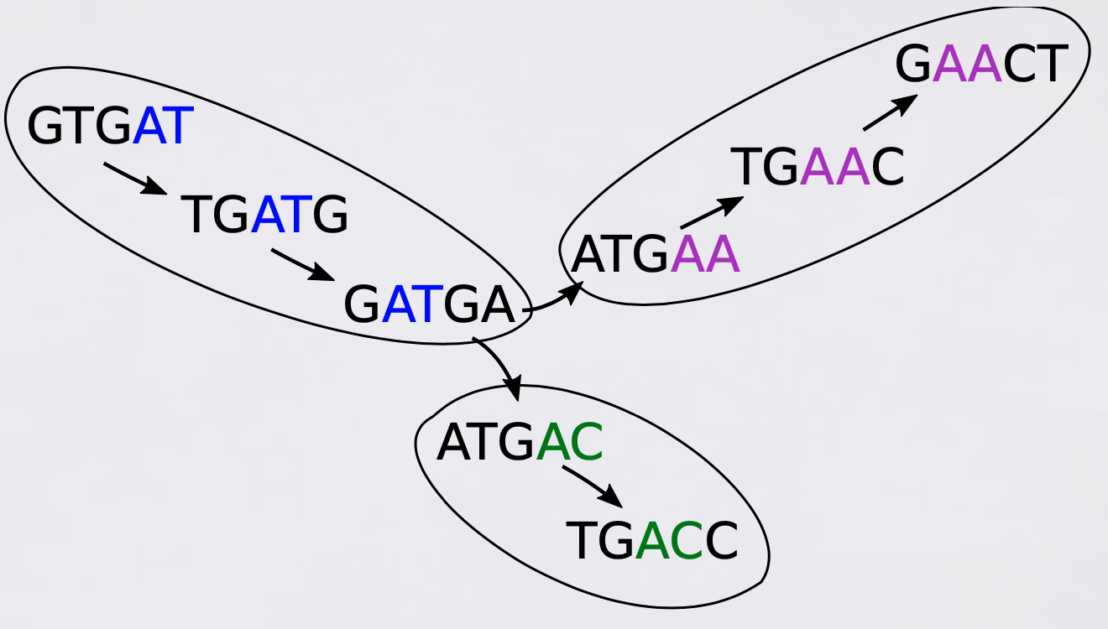
Compacting in parallel
GTGATGA
ATGACC
ATGAACT
Grouping kmers based on their minimizer to work it parallel.
BCALM2 is a tool for compacting the de Bruijn graph.

Slide 35


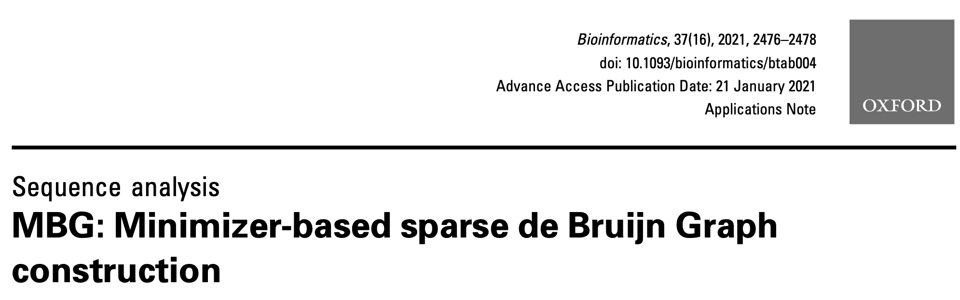
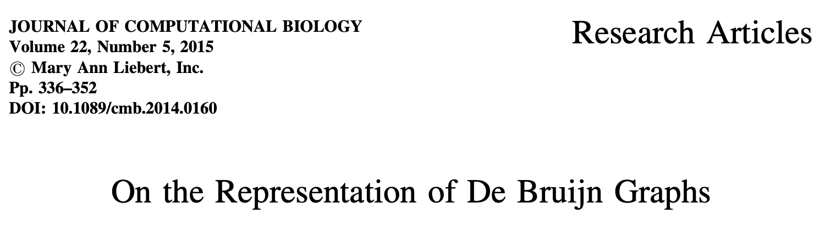
Too much math

Slide 36
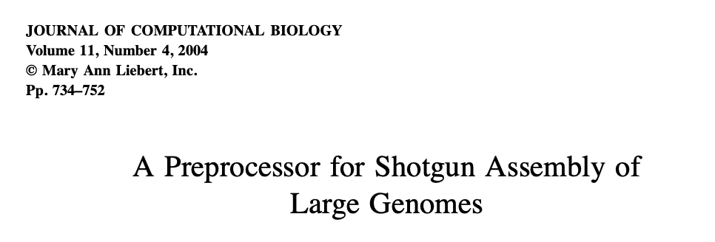



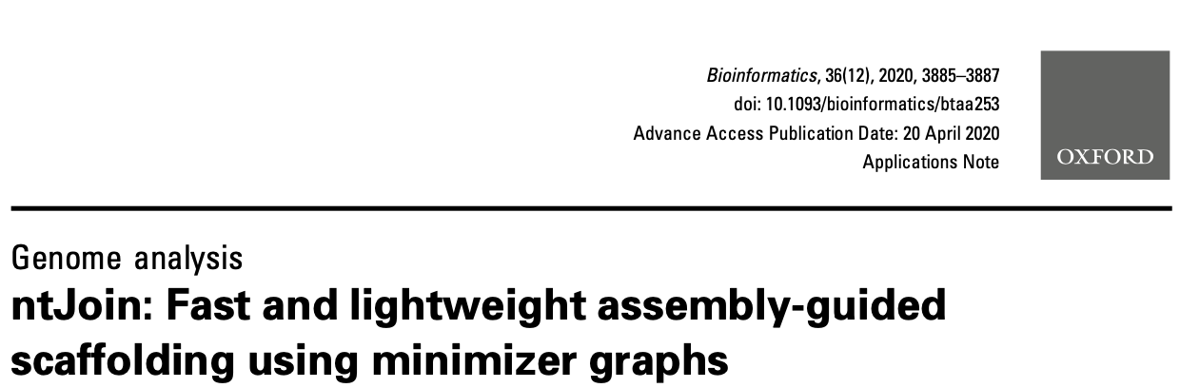
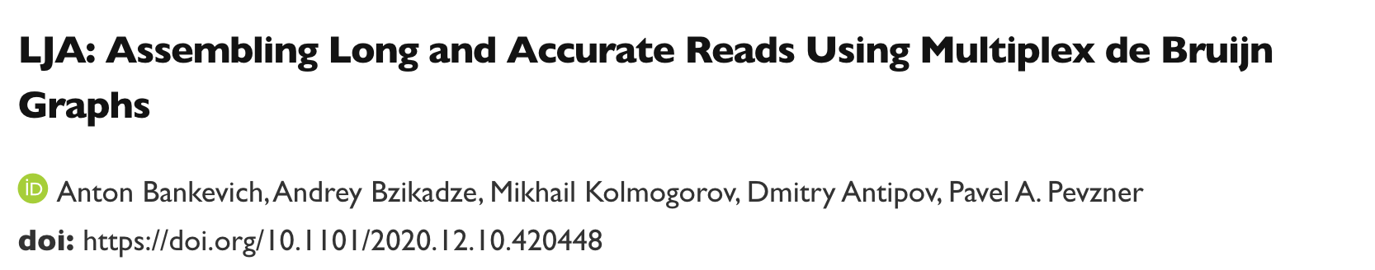
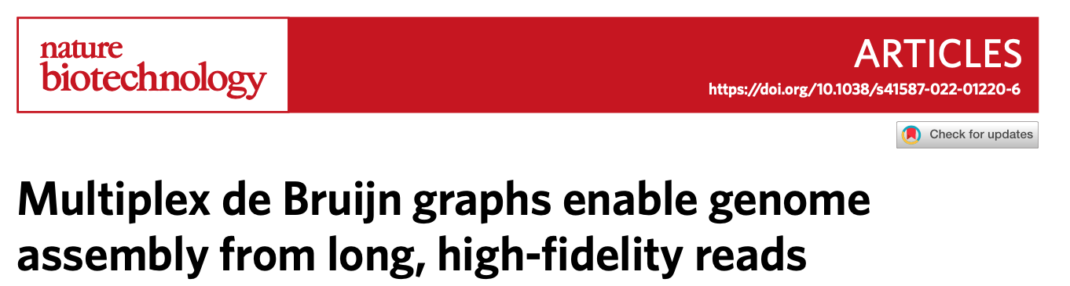

Slide 37
Applications
3- Kmer counting

Slide 38
K-mer counting
Given a string, counting the number of occurrences of every kmer.
Many applications
A naive approach:
count_dict={}; count_dict[‘ATA’]=1; count_dict[‘ATC’]=2.
k-mers as keys and their counts as values.
Efficient in terms of speed, space and memory
Parallelization: locking memory
Notes:
overlap-layout-consensus, find seeds based on #occurrences of k-mers
genome assembly, genome size estimation, read error correction, repeat annotation, multiple sequence alignment, GWAS.

Slide 39


JellyFish: based on Hash table
Gerbil: with minimizer
k-mers are stored as keys and their counts are stored as values.
Lock-free hash table allowing parallel insertion of k-mers and frequency updates.
CAG | 62
GGA | 33
Gerbil: a fast and memory-efficient k-mer counter with GPU-support, 2017
Notes:
2018, A benchmark study of k-mer counting methods for high-throughput sequencing.pdf
2011, A fast, lock-free approach for efficient parallel counting of occurrences of k-mers
using compare-and-swap method. Increment but double check previous value.

Slide 40

Evaluation
Data
Illumina reads
H. sapiens
292 GByte
System
memory: 64GB
Hard disk 1TB
CPUs 16
Intel CPU E5–2698 2.30GHz
Minimizer -> not equal bins
A benchmark study of k-mer counting methods for high-throughput sequencing , 2018

Slide 41








Universal hitting set
(not a priority)

Slide 42

Thank you!
QA?

Slide 43


Slide 44







Available reviews papers
Time order O(n)
Tutorial + basics
Useful, we can write similarly describing Biological applications.
Good supplementary describing basics
Intro on seeding, anchor, kmer
Two pages on Minimizer

Slide 45






4- Sequence compression

Slide 46





5- Sequence error correction
Not a priority

Slide 47




6- Variant calling & MSA

Slide 48






7- Read alignment
(good reviews exist)
Focused on minimizer

Slide 49








Alternative data structures
(math+computer sci.)
Notes:
Our focus is on applications.

Slide 50
Paper outline “Applications of Minimizer in genomics”
intro (importance, why now(biogenome project), definition)
metagenomics (7)
de Bruijn graph (4)
genome assembly (7)
kmer counting (5)
sequence compression (6)
sequence error correction (3)
variant calling (3)
Discussion and conclusion
Tables, figure.

Slide 51

De novo Nanopore read quality improvement using deep learning, BMC bioinformatics 2019

Slide 52

Error correction enables use of Oxford Nanopore technology for reference-free transcriptome analysis, Nature communication, 2021.

Slide 53



Vechat

Slide 54

Hash function
A hash function is any function that can be used to map data of arbitrary size to fixed-size values.
wikipedia
Notes:
wikipedia

Slide 55

Burrows–Wheeler transform
langmead-lab.org/teaching-materials/

Slide 56

Suffix array
BWT
langmead-lab.org/teaching-materials/

Slide 57

FM index
Using the BWT matrix
a last-to-first column mapping LF(i) from an index i to an index j, such that F[j] = L[i]

Slide 58

Bloom filter
a space-efficient probabilistic data structure
test whether an element is a member of a set
False positive matches are possible, but false negatives are not
An empty Bloom filter is a bit array of m bits, all set to 0.
Using k different hash functions
each function maps (hashes) an element to one of the m array positions.
Notes:
wikipedia

Slide 59

Notes:
https://www.youtube.com/watch?v=heEDL9usFgs&list=PLpPXw4zFa0uLMHwSZ7DMeLGjIUgo1IBbn&index=54

Slide 60


MinHASH
Notes:
Mash , Ondov et al. Genome Biology (2016) 17:132

Slide 61

StrobeMer

Slide 62
Read alignment
The aligners minimap (42) and minimap2 (43) are designed to align very long reads that have high error rates. These aligners use minimizers to anchor the alignment. First, all the minimizers of the reference sequence are computed and entered into a hash table, where the key is the sequence of the minimizer, and the value is a list of all the indices in the reference sequence where this k-mer is selected as the minimizer. In aligning a query sequence, the minimizers of the query are searched in the hash table for locations where the query might align.
Notes:
2019, tSketching and Sublinear Data Structures in Genomics .pdf

Slide 63

https://kamimrcht.github.io/webpage/sets_kmer_sets.html

Slide 64
I need two volunteers as two workers threads
I will be the memory and will answer you.
Let’s do it as role play.
You could either
Ask to read
Ask to increment
confirm

Slide 65

Time and space

Slide 66
Example:
workers W1 & W2.
W1, No, I won’t increment AAT as 1->2 does not hold
AAT | 1
ATT | 1
AAT | 2
ATT | 1
AAT | 2
ATT | 1
W1: read count of AAT (0)
W2: read count of ATT (0)
W1: increment AAT 0->1
W2: increment ATT 0->1
W1:
W2: read count AAT (1)
W1: read count AAT (1)
W2: increment AAT 1->2
W1: increment AAT 1->2
W2:
Notes:
2018, A benchmark study of k-mer counting methods for high-throughput sequencing.pdf
2011, A fast, lock-free approach for efficient parallel counting of occurrences of k-mers

Slide 67

Notes:
A super-mer of a genome sequence is defined as a substring of maximal length such that all k-mers on that substring share the same minimizer.

Slide 68
Sequence comparison with minimizer
Number of minimizer at most = L-w+1 but
Similar sequences have high probability of having the same minimizers.
Sequence of minimizers is also called a sketch of the original seq.
With non-overlapping windows -> L/w minimizers for sequence of length L.
For a random order (w not too large), a factor of 2/(w + 1).

Slide 69

Memory and speed; minimizer
partitioning input k-mers on disk
based on minimizers

Slide 70

BCALM 2
A tool for compacting the de Bruijn graph

Slide 71

Parallel counting:
splitting the sequence
Gerbil: with minimizer
Issues: missing kmers, combining stats of each part.
4-mers
3-mer minimizer (bold)
Finding (overlapping) part of sequence with the same minimizer on temp files
Gerbil: a fast and memory-efficient k-mer counter with GPU-support, 2017

